Slide 1
INTRODUCTION TO HTML
IICT
ANOUD ABDULLAH

Slide 2
WHAT IS HTML?
HTML stands for Hyper Text Markup Language
HTML is the standard markup language for creating Web pages
HTML describes the structure of a Web page
HTML consists of a series of elements
HTML elements tell the browser how to display the content
HTML elements label pieces of content such as "this is a heading", "this is a paragraph", "this is a link", etc.

Slide 3
What is HTML ? (Contd.)
HTML stands for Hyper Text Markup Language. It is used to design web pages using markup language.
HTML is the combination of Hypertext and Markup language. Hypertext defines the link between the web pages.
Markup language is used to define the text document within tag which defines the structure of web pages.
This language is used to annotate (make notes for the computer) text so that a machine can understand it and manipulate text accordingly.

Slide 4
What is HTML ? (Contd.)
Most markup languages (e.g. HTML) are human readable. Language uses tags to define what manipulation has to be done on the text.
HTML is a markup language used by the browser to manipulate text, images and other content, in order to display it in the required format. HTML was created by Tim Berners-Lee in 1991. The first ever version of HTML was HTML 1.0, but the first standard version was HTML 2.0, published in 1999.

Slide 5
More about HTML
HTML is Not Case Sensitive
HTML tags are not case sensitive: <P> means the same as <p>.

Slide 6
HTML Code (Hello World)
<head>
</head>
<body>
<h1> Hello World</h1>
</body>

Slide 7
HTML Code:
<!DOCTYPE html> <html> <head> <title>Page Title</title> </head> <body> <h1>My First Heading</h1> <p>My first paragraph.</p> </body> </html>

Slide 8
Explanation of Code:
The <!DOCTYPE html> declaration defines that this document is an HTML5 document
The <html> element is the root element of an HTML page
The <head> element contains meta information about the HTML page
The <title> element specifies a title for the HTML page (which is shown in the browser's title bar or in the page's tab)
The <body> element defines the document's body, and is a container for all the visible contents, such as headings, paragraphs, images, hyperlinks, tables, lists, etc.
The <h1> element defines a large heading
The <p> element defines a paragraph

Slide 9
Web Browsers
The purpose of a web browser (Chrome, Edge, Firefox, Safari) is to read HTML documents and display them correctly.
A browser does not display the HTML tags, but uses them to determine how to display the document:

Slide 10
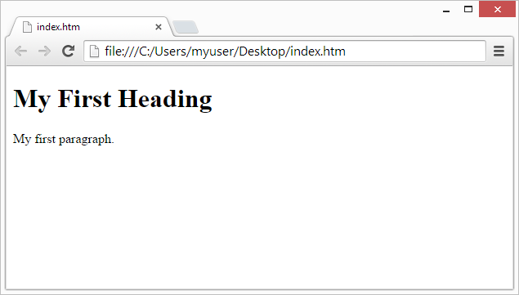
Output:
Web Browsers
The purpose of a web browser (Chrome, Edge, Firefox, Safari) is to read HTML documents and display them correctly.
A browser does not display the HTML tags, but uses them to determine how to display the document:

Slide 11
HTML Formatting elements:
Formatting elements were designed to display special types of text:
<b> - Bold text
<strong> - Important text
<i> - Italic text
<em> - Emphasized text
<mark> - Marked text
<small> - Smaller text
<del> - Deleted text
<ins> - Inserted text
<sub> - Subscript text
<sup> - Superscript text

Slide 12
Features of HTML:
It is easy to learn and easy to use.
It is platform independent.
Images, video and audio can be added to a web page.
Hypertext can be added to text.
It is a markup language.

Slide 13
Why learn HTML?
It is a simple markup language. Its implementation is easy.
It is used to create a website.
Helps in developing fundamentals about web programming.
Boost professional career.

Slide 14
Advantages:
HTML is used to build websites.
It is supported by all browsers.
It can be integrated with other languages like CSS, JavaScript etc.

Slide 15
Disadvantages:
HTML can only create static web pages. For dynamic web pages, other languages have to be used.
A large amount of code has to be written to create a simple web page.
Security feature is not good.

Slide 16
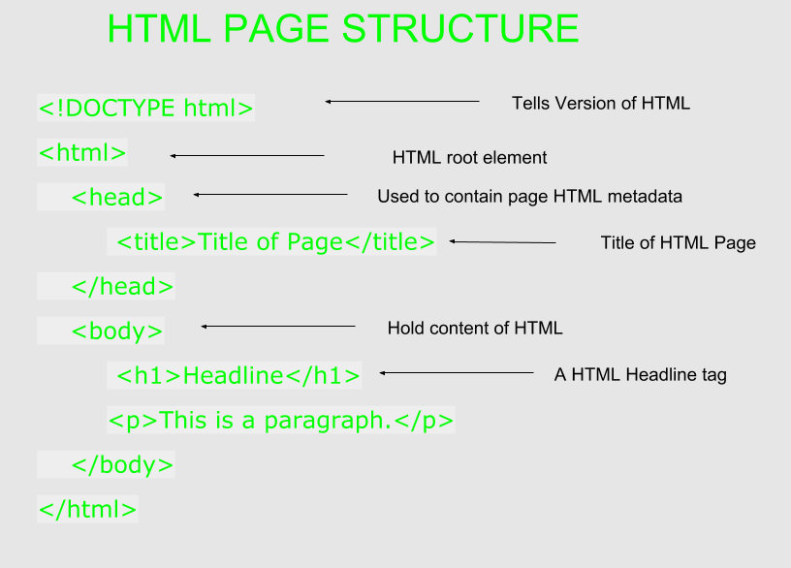
HTML Page Structure

Slide 17
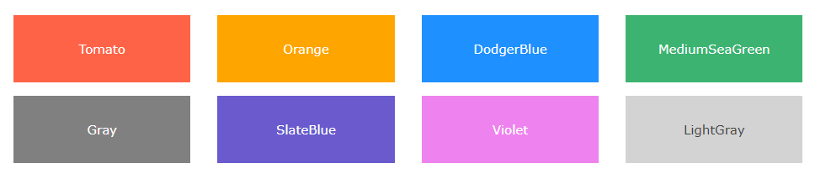
Color Names:
In HTML, a color can be specified by using a color name:

Slide 18
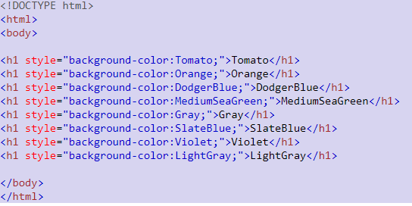
Try this Code: (Background color)

Slide 19
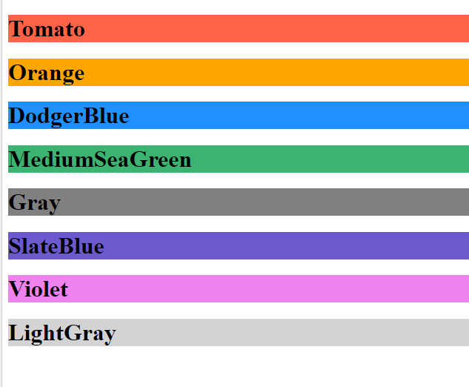
Output:

Slide 20
Text Color:
You can set the color of text.
Example:
<h1 style="color:Tomato;">Hello Section 1 & 2</h1>
<p style="color:DodgerBlue;">Have you submitted your assignment ?????? </p>
<p style="color:MediumSeaGreen;">Did you appear in you midterms? </p>

Slide 21
Border Color:
Code:
<h1 style="border:2px solid Tomato;">Hello World</h1> <h1 style="border:2px solid DodgerBlue;">Hello World</h1> <h1 style="border:2px solid Violet;">Hello World</h1>

